Slide 1




Implementation of a Chatbot
A Comparative Study of RNN, GRU, LSTM, Transformer, MLP
Presented By: SHEHRYAR SHEHRYAR Student ID: P2952028 Course: Natural Language Processing Date: 13/November/2025

Slide 2
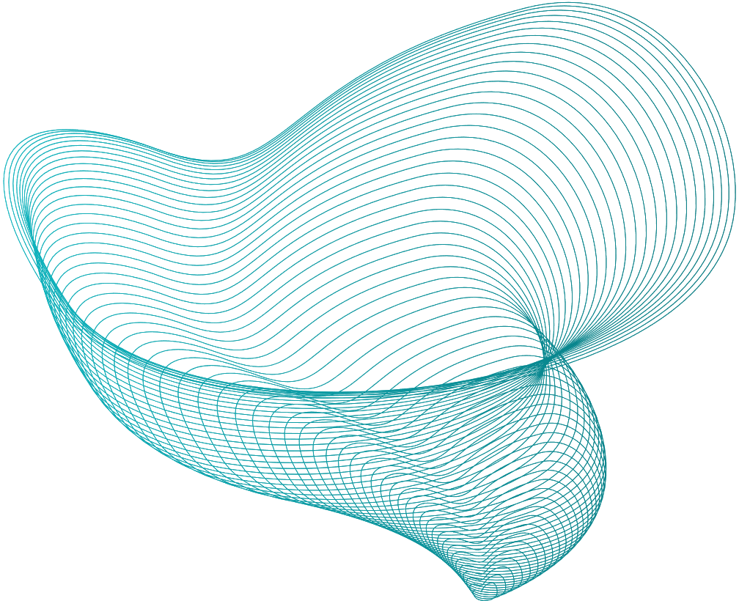

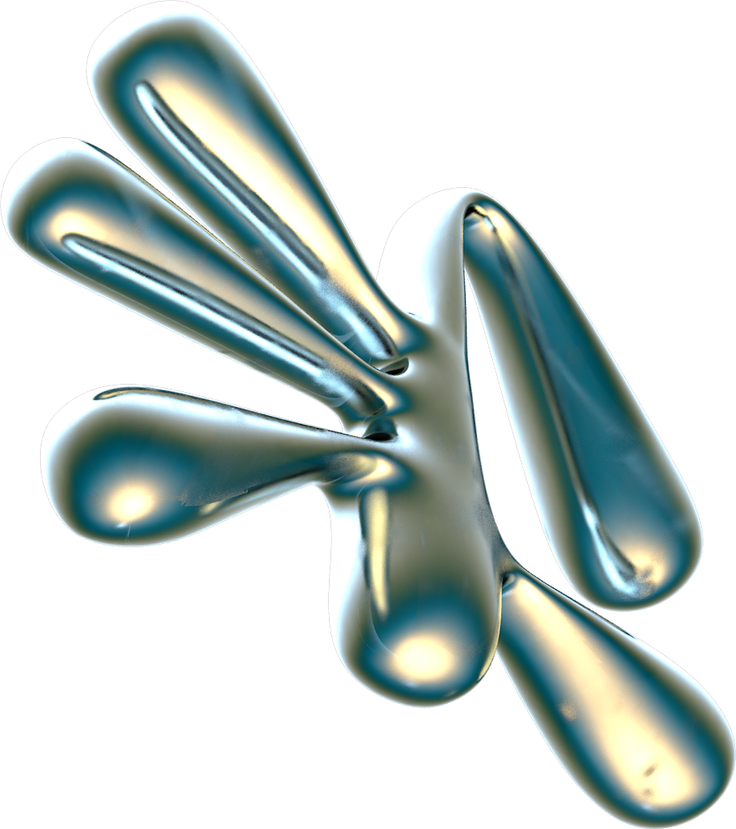
TABLE OF CONTENTS
01.
02.
03.
04.
05.
Introduction
Objectives / Goals
Methodology
DATA/MATERIALS
Implementation
06.
07.
08.
09.
10.
Results
Discussion
Conclusion/Summary
Future Work
Reference

Slide 3


INTRODUCTION

Slide 4

INTRODUCTION:
This project focuses on developing an AI-powered chatbot capable of producing human-like responses using Natural Language Processing and Deep Learning.
It uses a custom dataset of question–answer pairs related to general greetings, AI concepts, and Python programming.
The chatbot integrates multiple neural models (RNN, GRU, LSTM, Transformer and MLP) to analyze, compare, and generate intelligent conversational replies.

Slide 5

Objectives/ Goals

Slide 6
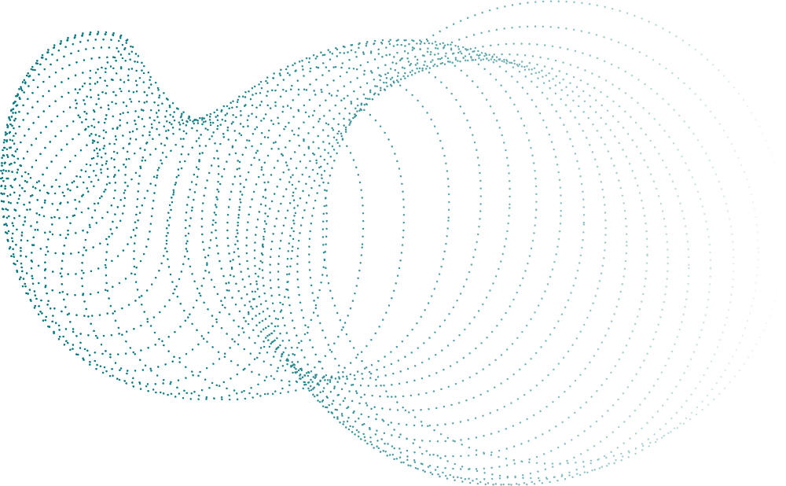
Objectives / Goals
The main goal of this phase is to evaluate the chatbot models (RNN, GRU, LSTM, Transformer, and MLP) based on multiple performance indicators.
The evaluation uses BLEU scores, validation accuracy, and loss curves to measure translation quality and model generalization.
Implement and compare of different architectures.
Demonstrate fine-tuning and model experimentation.

Slide 7
MODELS
1. RNN (Recurrent Neural Network) A recurrent neural network (RNN) is a type of deep learning model designed to process sequential data, such as text, speech, or time-series data. (Data Arranged Ordered Data)
2. GRU (Gated Recurrent Unit) A Gated Recurrent Unit (GRU) is a type of recurrent neural network (RNN) that uses a gating mechanism to regulate information flow, which helps solve the vanishing gradient problem in standard RNNs and allows it to learn long-term dependencies in sequential data like text or time series
3. LSTM (Long Short-Term Memory) An LSTM (Long Short-Term Memory) model is a type of recurrent neural network (RNN) designed to learn long-term dependencies in sequential data, such as time series, text, and speech
4. Transformer (Self-Attention based) This allows it to understand context and relationships between words, even in long sentences, making it more efficient and faster than previous models for tasks like translation, text generation, and summarization.
5. MLP (Multi-Layer Perceptron) feedforward artificial neural network used in machine learning. It is designed to model complex, non-linear relationships in data and is widely applied for tasks such as classification, regression, and pattern recognition.

Slide 8
Methodology / Approach

Slide 9
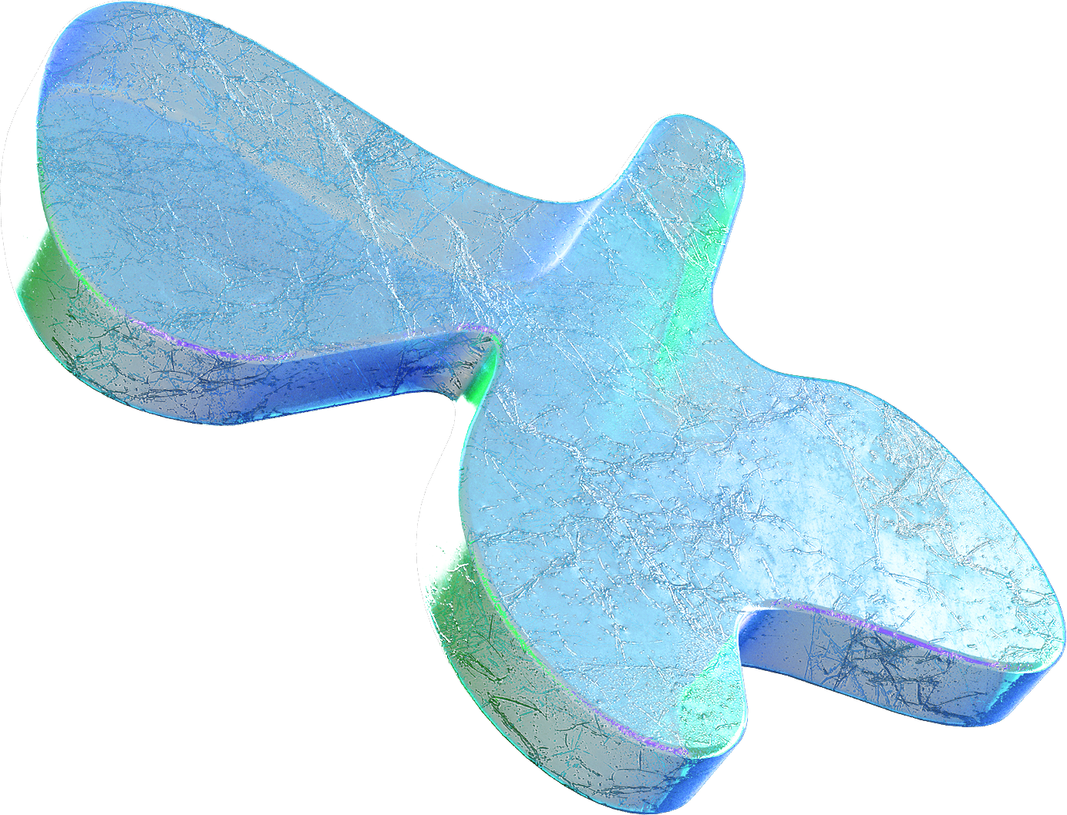

Methodology / Approach
Data Preparation: Create and preprocess chatbot Q&A dataset.
Model Design: Implement RNN, MLP, ….. architectures.
3. Training: Use PyTorch with Adam optimizer and CrossEntropy loss.
4. Fine-Tuning: Adjust embedding size, learning rate, and layers.
5. Evaluation: Analyze BLEU scores and loss curves for comparison.

Slide 10
Data / Materials / Inputs

Slide 11
Data /Material /Input
Dataset: Custom Q&A pairs covering greetings, AI, and Python topics.
Tools & Libraries: Python, PyTorch, NLTK, Matplotlib.
Preprocessing: Tokenization, padding, and vocabulary creation with <PAD>, <SOS>, <EOS>, <UNK> tokens.
Hardware: GPU-enabled environment for training.

Slide 12
Implementation / Process

Slide 13
Implementation / Process
RNN: Sequence-to-sequence model using GRU encoder-decoder.
CNN: 1D convolutional network capturing local text patterns.
MLP: Fully connected feedforward network as baseline.
Each model uses embedding layers for semantic representation.
Training: 18 epochs with teacher forcing for RNN and comparative setup for CNN, MLP.

Slide 14
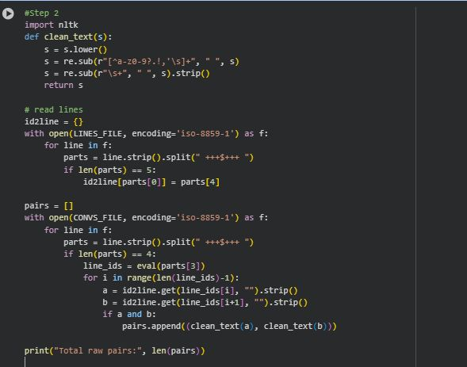
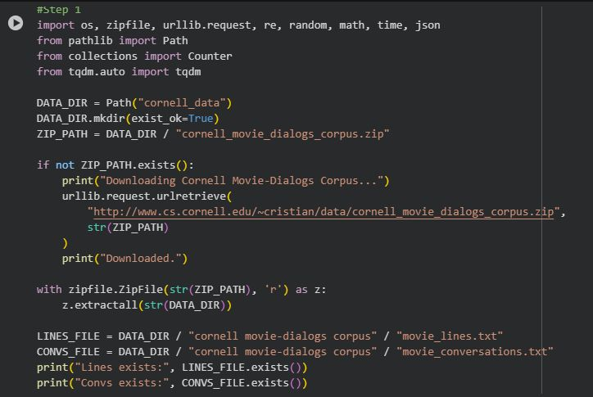
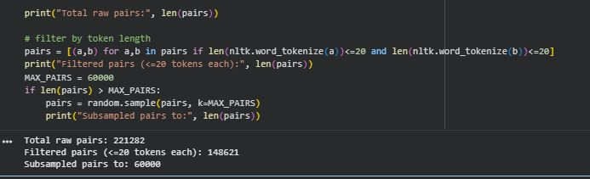
CODE:
Image#2: Clean Dataset
Image#1: Data Loading
Image#3: Filter Dataset

Slide 15
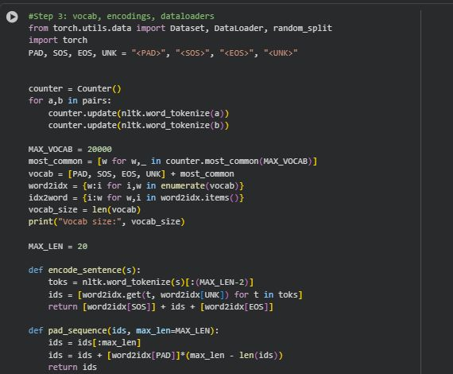
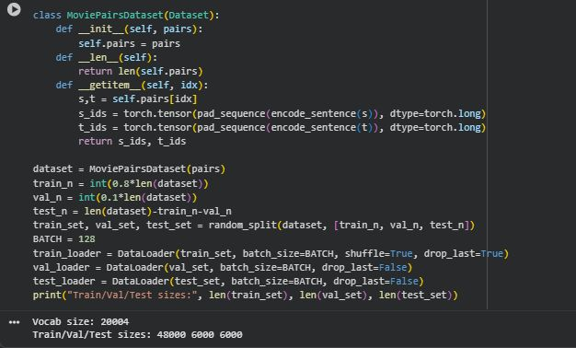
Image#5: Dataloads
Image#4: Vocabulary

Slide 16
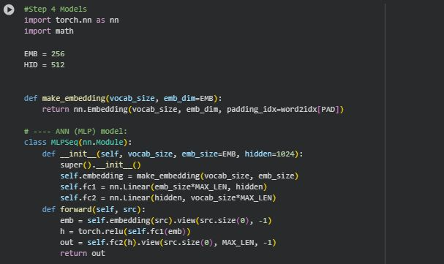
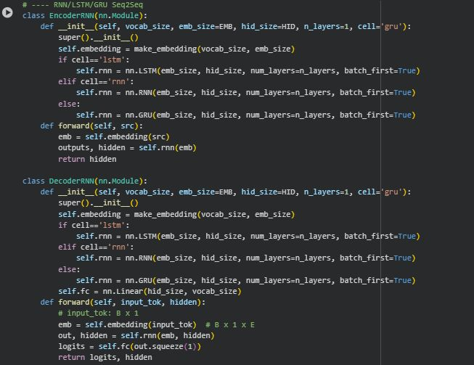
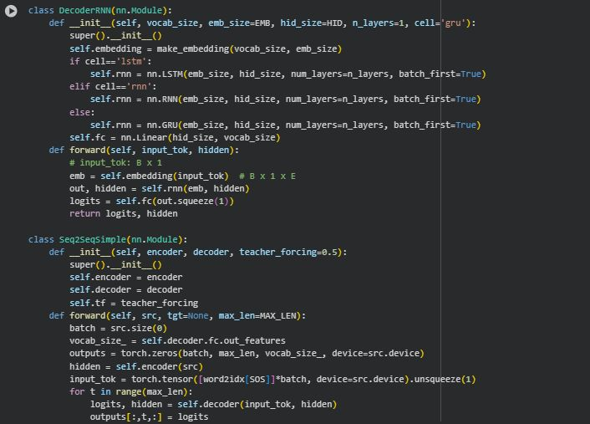
ANN Visualization
RNN/LSTM/GRU
Image 6: ANN Model
RNN/SEQ2SEQ

Slide 17
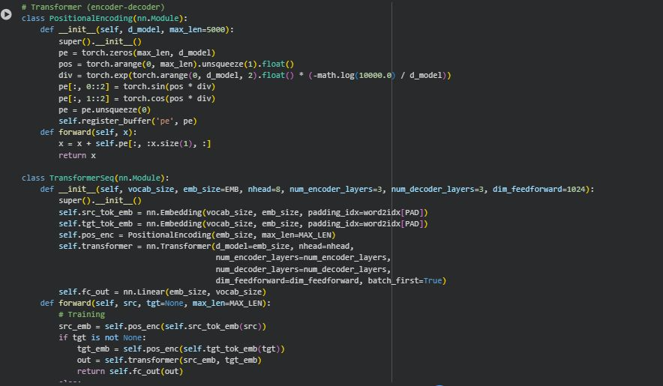
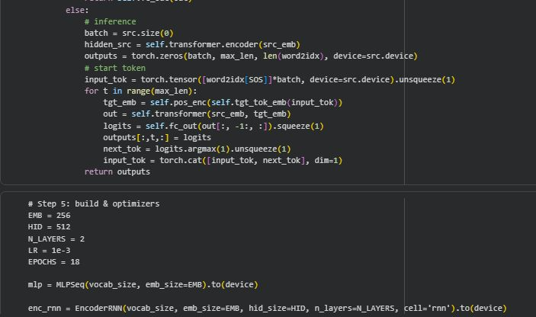
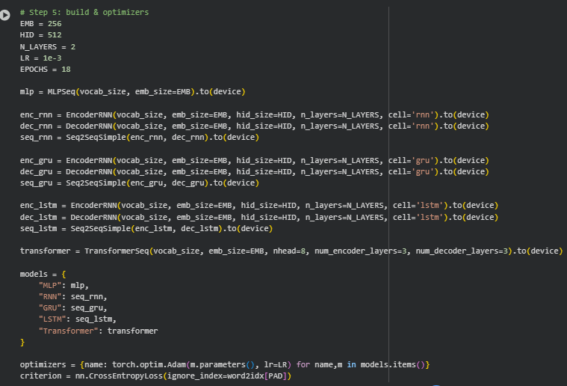
Transformer P2
Transformer P1
Build Data

Slide 18
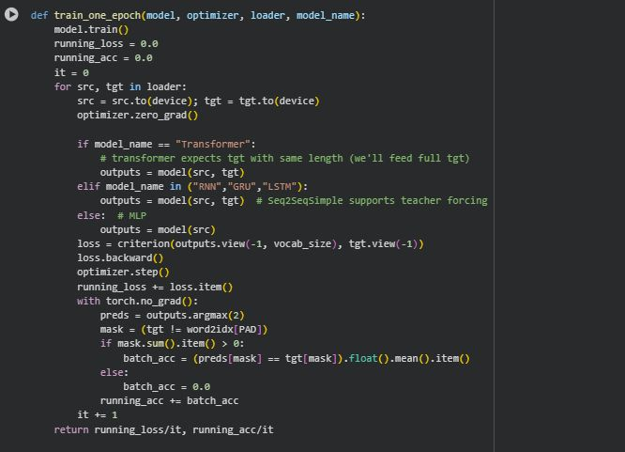
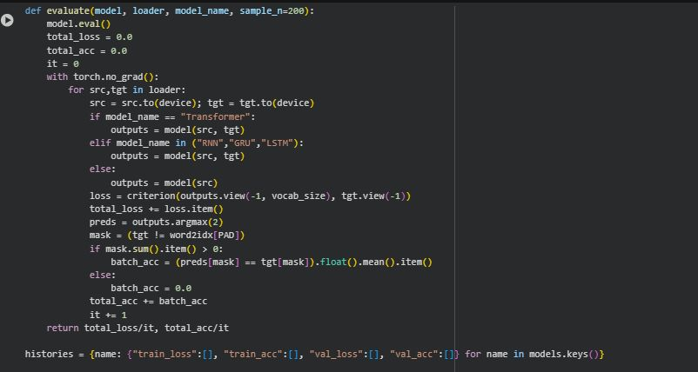
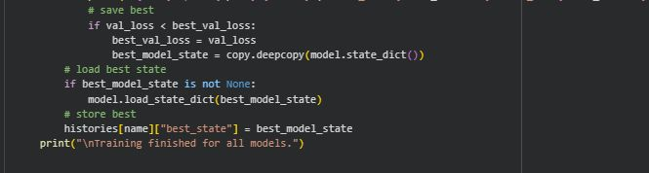
Training P2
Training P3
Training P1

Slide 19
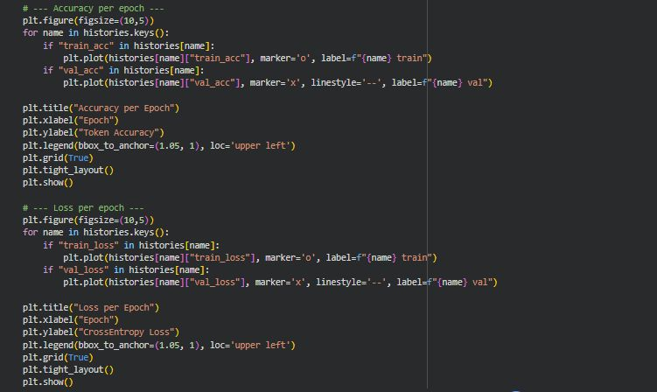
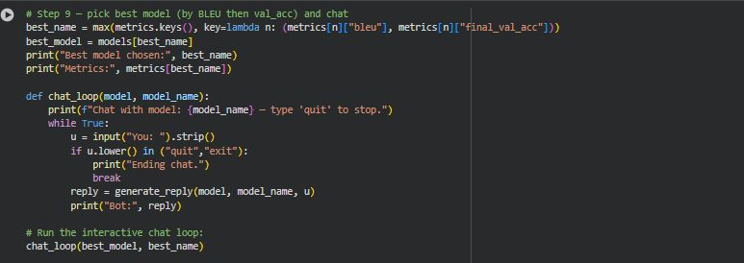
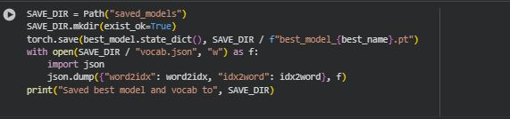
Bot User
Chart
Save

Slide 20
Results / Findings

Slide 21
Results / Findings
Bar charts display BLEU and final validation accuracy for all models.
Transformer achieved the highest BLEU, showing better contextual understanding.
Recurrent models performed moderately well, while MLP underperformed due to lack of sequence awareness.

Slide 22
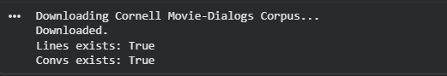


Output:
Download Data
Filtered Data
Vocab Size and Training Size

Slide 23
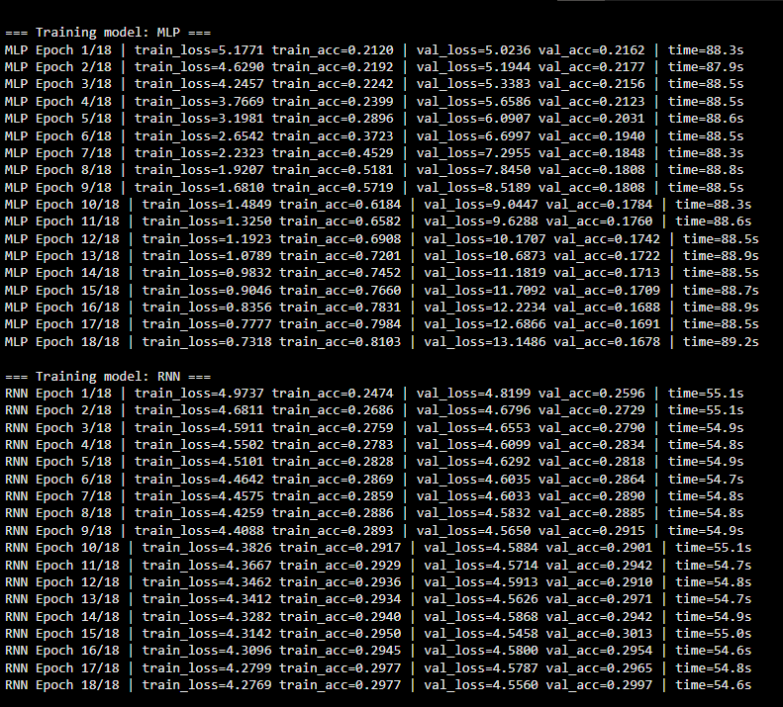
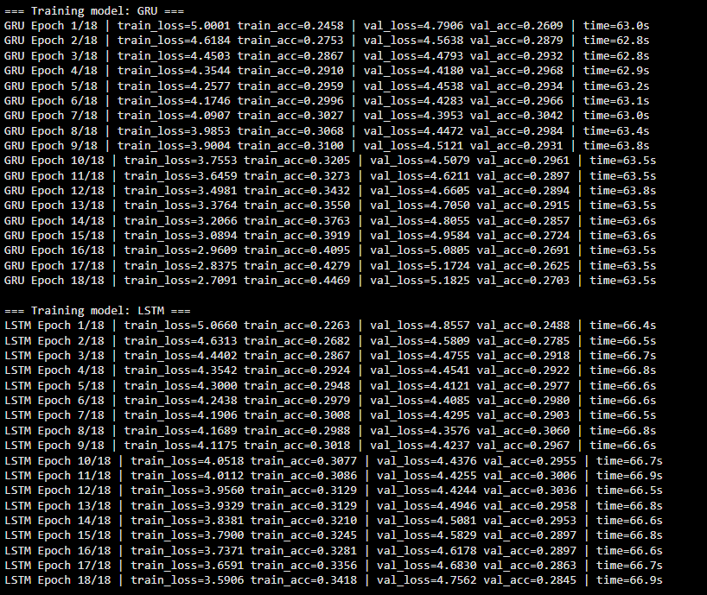
Training MLP & RNN
Training GRU & LSTM

Slide 24
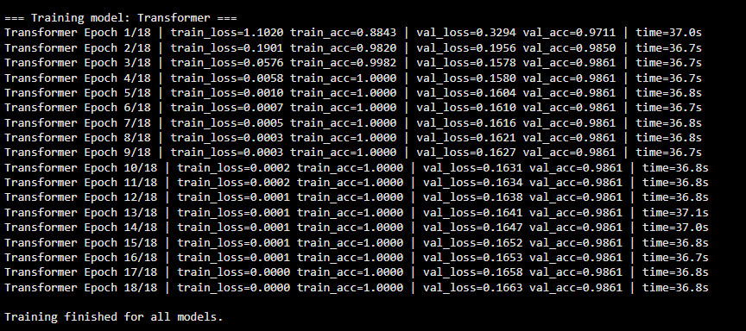
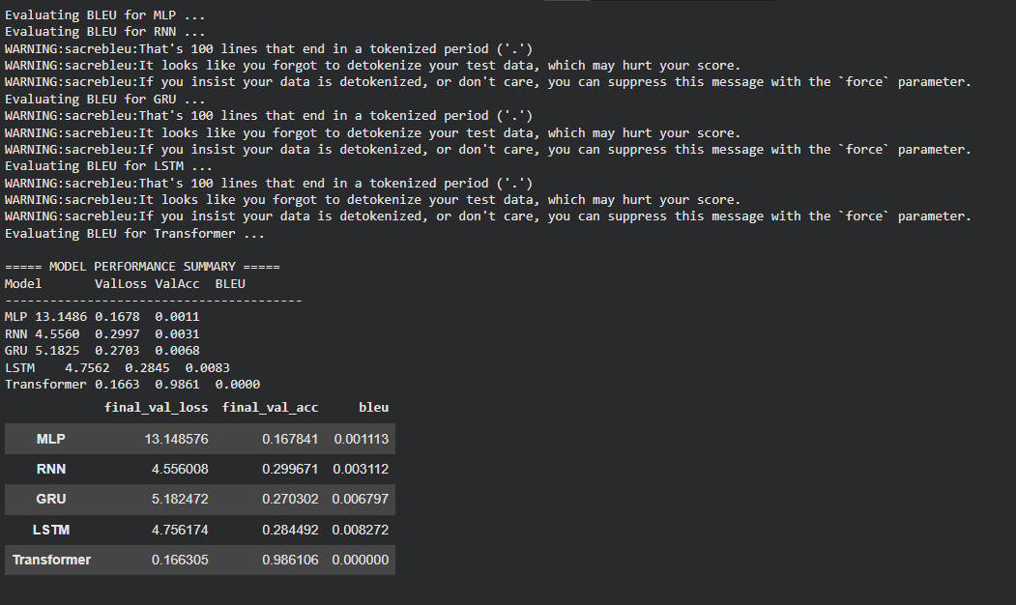
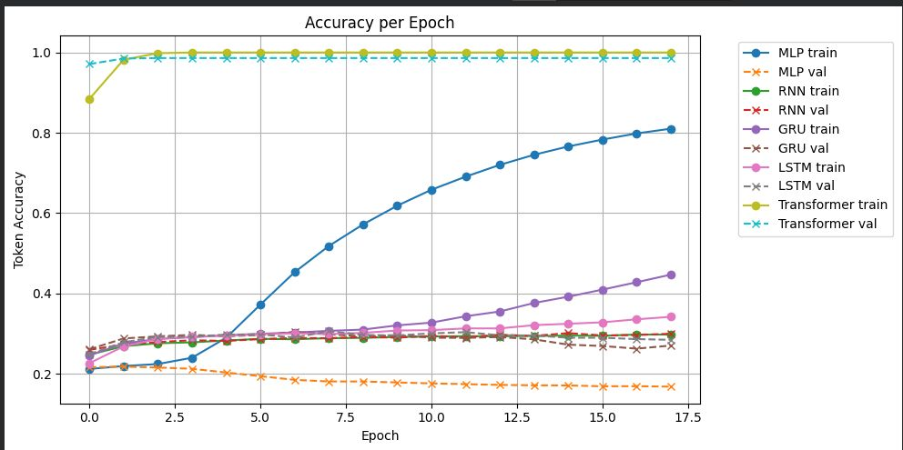
Training Transformer
Bleu
Accuracy

Slide 25
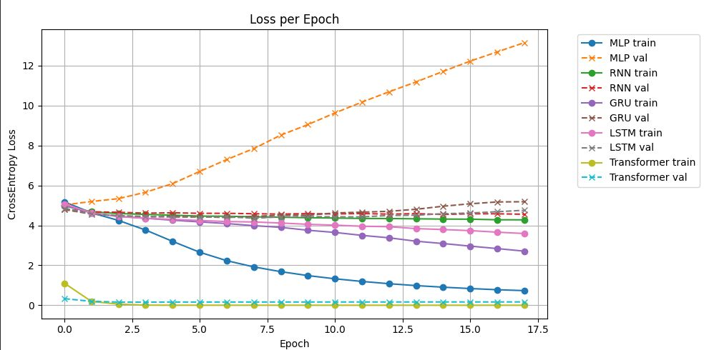
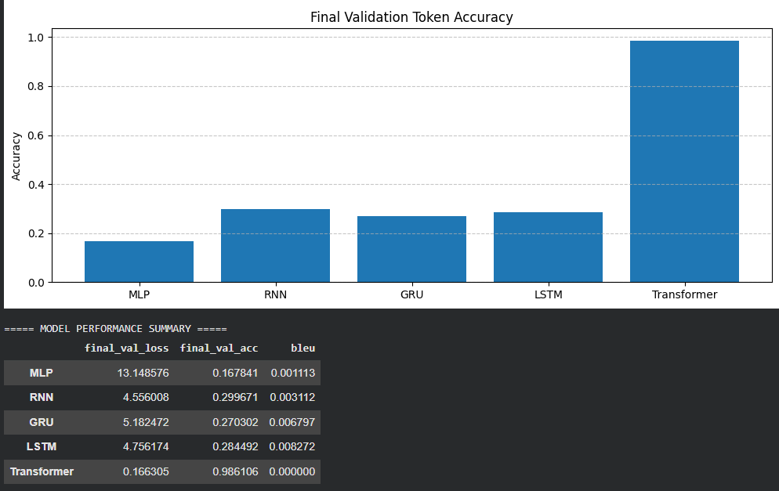
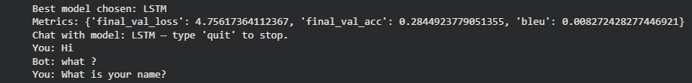
Graph Loss
Comparison
Chat

Slide 26
Discussion / Interpretation

Slide 27
Discussion / Interpretation
The evaluation revealed key insights into the strengths of each model:
Transformers excel at context-rich responses due to self-attention.
LSTM and GRU provided stable but less dynamic results.
BLEU scores confirmed that attention-based architectures outperform traditional RNNs in dialogue generation.
This analysis highlights how combining multiple metrics (BLEU, loss, accuracy) gives a clearer view of chatbot performance.

Slide 28

Future Work / Acknowledgments

Slide 29
Future Work / Acknowledgments
In the future, the chatbot can be enhanced by integrating larger transformer-based models like GPT, BERT and Llama for improved contextual understanding.
Adding reinforcement learning can make the responses more adaptive to user feedback.
Moreover, incorporating emotion and intent detection could make interactions more natural and human-like.

Slide 30
Reference:
Hochreiter, S., & Schmidhuber, J. (1997). Long short-term memory. Neural Computation, 9(8), 1735–1780. https://doi.org/10.1162/neco.1997.9.8.1735
Miller, G. A. (1995). WordNet: a lexical database for English. Communications of the ACM, 38(11), 39–41. https://doi.org/10.1145/219717.219748
Cho, K., Van Merriënboer, B., Gulcehre, C., Bahdanau, D., Bougares, F., Schwenk, H., & Bengio, Y. (2014). Learning phrase representations using RNN encoder–decoder for statistical machine translation. arXiv preprint arXiv:1406.1078.
Papineni, K., Roukos, S., Ward, T., & Zhu, W. J. (2002). BLEU: a method for automatic evaluation of machine translation. In Proceedings of the 40th Annual Meeting on Association for Computational Linguistics (pp. 311–318).

